Slide 1
Farmers, shields and money
An iterative approach to the rise of the Greek Polis

Slide 2
Introduction
Mike Lally
Fairport, NY
Historical Studies
Ancient History
Project Manager/Scrum Master
Notes:
Good morning. Thanks for joining me today.
My name is Mike Lally. I am from Fairport, NY which is outside of Rochester, NY.
I am working towards a degree in Historical Studies with a possible concentration in Ancient History.
In my professional life, I am an Project Manager and Scrum Master for ShoreTel.
SCRUM is a software development framework that uses iterations or sprints to ensure the delivery of working code.

Slide 3
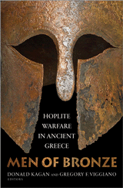
Why Hoplites?
Donald Kagan
Introduction to Ancient Greek History
Men of Bronze
Notes:
In 2012, I found Donald Kagan’s Introduction to Ancient Greek History lectures from Yale while rehabbing from back surgery.
My rehab consisted of walking. So…
I downloaded the lectures onto my phone and away I went.
I became a HUGE fan of Donald Kagan.
In 2008, Kagan put on a conference at Yale that gathered the leading thinkers in the debate around the influence hoplites had in the rise of the Greek Polis.
This is referred to as the hoplite orthodoxy or the hoplite narrative.
In 2013, Kagan published Men of Bronze.
MoB It is a collection of the positions detailed from that conference.
And it has had a big impact on me.

Slide 4
Notes:
This is a HOPLITE.
He is a heavily armed and armored infantryman from Ancient Greece.
Prior to the hoplite, the majority of fighting was done with cavalry.
You had to be wealthy to afford a horse so therefore, ALL warriors were ELITE ARISTOCRATS.
As I mentioned, there is a great academic debate concerning the influence of HOPLITES in the rise of the Greek POLIS.
Today, I will talk about the competing sides in this debate and their theories.
Then, I will share my proposed solution – an iterative model – which attempts to synthesize the arguments.
By the end of this session, my hope is that you will understand the hoplite debate and my humble attempt to reconcile the opposing theories.

Slide 5
Greek Polis
8th c. – 6th c. BC
Hereditary aristocracies / Tyrants
Beginnings of democracy
Monarchies to republics
Lack of available arable land
Notes:
Let’s talk about the Polis before we dive in.
We are considering a time period of HUNDREDS of years – the 8th c. thru the 6th c. BC
During this period, we see the transfer of political power from aristocracies to the beginnings of democracy.
By the 7th c. there was a universal hatred for the idea of PERMANENT HEREDITARY rule.
This is the time of TYRANTS.
By the early 6th c. Solon, in Athens, had instituted democratic reforms.
Lack of land available for a growing population
We start to see citizens providing their own arms to defend the polis IN RETURN for political privileges.
Hoplites drove the tyrants from power and created broad oligarchies in their place.

Slide 6
Hoplite Orthodoxy Defined
Kagan’s definition
Sudden innovations in arms and armor
Phalanx tactics
Hoplites emerged from a middling group
Group transformed Greek values
Notes:
Donald Kagan gives us a summary of the Hoplite Orthodox in “Men of Bronze” and I will use it here.
“A central part of the thesis is that the change in fighting style was directly related to recent innovations in arms and armor.
Second, the phalanx depended on the weight and the cohesion of heavily armed men who employed “shock” tactics in brief but decisive battles.
Third, it has been critical to identify the greatest number of hoplites with a middling group within the polis, which had the WEALTH to provide its own arms.
Fourth, this middling group transformed Greek values. “ Kagan

Slide 7
Innovation in arms and armor
Notes:
Let’s explore the Orthodoxy.
The Orthodoxy believe in a SUDDEN CHANGE in arms and armor around 700 BC.
Most importantly, the double grip shield.
The hoplite slides his arm through the middle of the shield and grips it towards the rim.
The shield is heavy. It weighs about 15 pounds.
It is 3 feet in diameter.
This type of shield protected the wearer’s left side but exposed his right flank.
The adoption of the shield essentially forced the adoption of the phalanx.

Slide 8
Notes:
Here he is again in his full kit.
Note the greaves to protect his legs, the breastplate, and the helmet.
The full kit is HEAVY. It has been estimated to weigh 70 pounds.

Slide 9
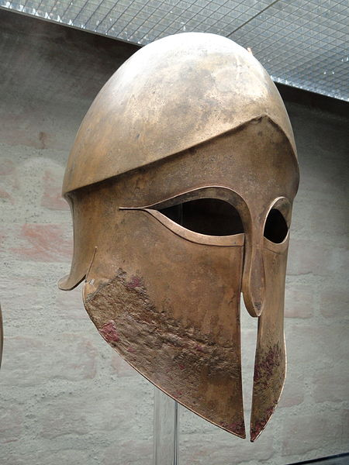
Notes:
This is an earlier version of the typical helmet used by a hoplite.
It is referred to as a “Corinthian helmet”.
Notice the limited openings around the eyes.
Notice the lack of ear holes
If you were to run around a battlefield, this is not a good piece of equipment.
It is HEAVY. You can BARELY see and you CANT HEAR!

Slide 10
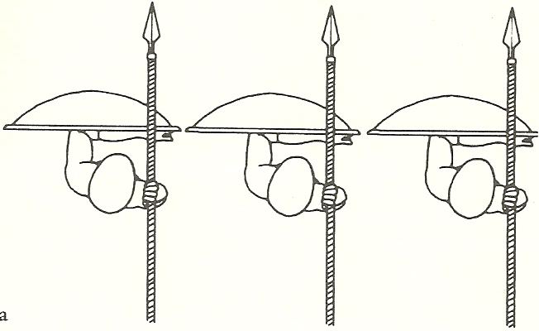
Phalanx
Notes:
The 2nd aspect of the orthodox is the tactics of the phalanx.
In a phalanx, hoplites would line up side by side and 8 or more rows deep.
They hold the shield in front of them protect their bodies and the left of the man next to them.
Cohesion was critical. If you wavered or drop your shield, you exposed the man to your right.

Slide 11
Phalanx
Notes:
This is a photo from the Chigi (Key-gee) vase.
It is a 2-D representation of a phalanx.
The artist shows interlocking legs to depict rows of men moving in close order.

Slide 12
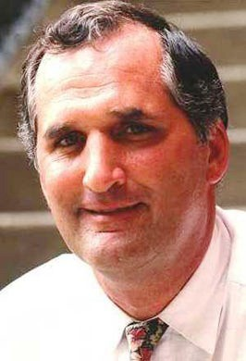
The Contenders
Victor Davis Hanson
Hans van Wees
John R. Hale
Notes:
Let’s get into this battle between the Orthodoxy versus the revisionists.
Hanson for the Orthodox.
Van Wees for the Revisionists. The Revisionists take issue with every aspect of the Orthodox. Van Wees is no exception.
John Hale is also a Revisionist but he has a very unique idea that I find very compelling.

Slide 13
Scoreboard
Orthodox Definition | Hanson | Van Wees | Hale
Sudden change in arms and armor
Hoplite phalanx depended on closed order battle
Hoplites emerged from a Middling group that bought their own gear
Middling group transformed Greek values
Notes:
I thought I would help you all follow along by creating a scoreboard.
After I talk about each contender, I will bring this back to show where we stand.

Slide 14
Hanson (Orthodox)
The Western Way of War & The Other Greeks
Its about protecting the farm land
Middling group were farmers
Sudden Change in arms and armor
New arms and armor mandated the phalanx
Othismos
Notes:
Victor Davis Hanson has written many books. Two in particular concern themselves with the Hoplite Orthodoxy.
Hanson feels that the REAL social, political, economic and military issues in Ancient Greece were always about the lack of land available to farm.
Overpopulation and land hunger placed a premium on farm land.
It forced the elites to relinquish some of their military dominance.
Hanson supports the idea that hoplites emerged from an expanding class of middling farmers and these farmers forced CHANGE.
To Hanson, the tactic was to smash a line of heavily armed men into the enemy’s line of similarly armed men and seek to push them back or develop a tear or gap in the line.
Hanson supports this idea of “the push” or OTHISMOS.
He cites many ancient sources who all wrote about this “push of shields” – Herodotus, Thucydides, Xenophon, Polybius, Arrian, Plutarch and more.

Slide 15
Scoreboard
Orthodox Definition | Hanson | Van Wees | Hale
Sudden change in arms and armor | Yes
Hoplite phalanx depended on closed order battle | Yes
Hoplites emerged from a Middling group that bought their own gear | Yes
Middling group transformed Greek values | Yes
Notes:
Hanson is really the last holdout of the orthodoxy.

Slide 16
Van Wees (Revisionist)
The Homeric Way of War: The “Iliad” and the Hoplite Phalanx
Double-grip shield not a big deal
Phalanx not primary form of combat
Hoplites emerged from aristocrats
Not a force of political change
Notes:
On to the revisionists. They take exception to every aspect of the orthodox.
Van Wees does “not believe that the introduction of the double-grip shield greatly accelerated the growth of the phalanx.”
Nor does he believe that a phalanx of hoplites was prominently used in battle until the 7th c BC.
Van Wees argues for “the reduced role of the phalanx as an instrument of military and therefore political change.”
He very much supports the idea that combat was open ordered.
He believes that hoplites emerged from the existing aristocracy or leisure-class and they fought for their individual polis and did so out of a sense of honor and duty.
Van Wees allows for an agrarian revolution but in the 3rd c. BC! HUNDREDS of years later.

Slide 17
Phalanx vs. Open Order
Notes:
Van Wees argues against the phalanx.
He feels battles were fought in more of an OPEN formation.
In the picture, the top row represents a close order phalanx. Shield to shield.
The bottom picture represents an open order formation. There is approximately 6 feet between each man.

Slide 18
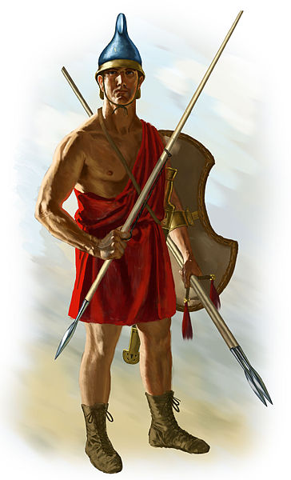
More Van Wees
Weapon | Iliad
Spear (cast) | 87 | 42%
Spear (thrust) | 79 | 38%
Spear (all) | 166 | 81%
Sword | 19 | 9%
Arrow | 21 | 10%
Total | 206
Notes:
Picture is of a peltast or skirmisher.
He is lightly armored – only helmet and shield.
Javelins for throwing. Not a spear for thrusting.
Van Wees analyzed the TYPES of fighting styles mentioned in The Iliad to prove his theory that combat was more open-ordered.
The Iliad is dated to the early to mid 8th c. BC 760 -710 BC. It covers the period of the Trojan War.
I have to acknowledge that Homer is NOT a reliable source. The Iliad is a story. Its not historical fact.
I love the breakdown of spear CASTS vs. THRUSTS. In a phalanx, we would see all THRUSTS.
Basically – champions pick out other champions to fight while the open order infantry skirmish about throwing spears, javelins or stones.
Van Wees concludes that open order and closed order fighting happened simultaneously.

Slide 19
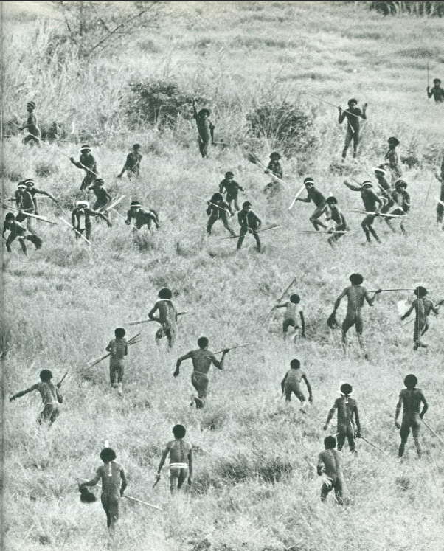
Gardens of War
Notes:
Photos that Van Wees references from Gardens of War: Life and Death in the New Guinea Stone Age.
From 1974!
Gives a good idea of what open ordered combat looks like.

Slide 20
Scoreboard
Orthodox Definition | Hanson | Van Wees | Hale
Sudden change in arms and armor | Yes | No. Slow adoption
Hoplite phalanx depended on closed order battle | Yes | No. Battle was mixed.
Hoplites emerged from a Middling group that bought their own gear | Yes | No. Hoplites were Aristocrats
Middling group transformed Greek values | Yes | No. Aristocrats fought for their individual polis
Notes:
Let’s recap. Hanson is in full support of the orthodox definition.
Adoption of the double-grip shield and other armor led to hoplites fighting in a phalanx.
Hoplites were FARMERS that had enough money or wealth to BUY the armor.
Those same HOPLITE FARMERS or FARMER HOPLITES pushed for a greater voice in their polis.
Revisionists take exception to every.single.point.
Slow adoption of hoplite arms and armor.
Open ordered happened along-side closed-ordered.
Hoplites were aristocrats, not farmers.
Those elites fought out of a sense of duty and honor.

Slide 21
John R. Hale
Nino Luraghi’s “Traders, Pirates, Warriors: The Proto-History of Greek Mercenary Soliders in the Eastern Mediterranean”
Hoplites as MERCENARIES
Proof in documents from Egypt
Poetry of Archilochus and Alcaeus
Amathus Bowl
Notes:
Then John R. Hale comes along and throws a bit of a monkey wrench into the debate.
Hale attempts to track “early hoplites into a realm where private enterprise, not public service was the guiding star” for emerging hoplites.
Hale relies heavily on Nino Luragh’s paper: “Traders, Pirates, Warriors: The Proto-History of Greek Mercenary Soliders in the Eastern Mediterranean”
He lets Luraghi make his case for him.
Luraghi builds a very strong case that Hoplites were operating in Assyria as early as 732 BC.
The most compelling piece of evidence is the Amathus bowl.

Slide 22
Notes:
It was discovered in 1875 near the city of Amathus in Cyprus.
It is dated to sometime between 710 and 675 BC.
It was crafted in silver by a Phoenician craftsman.
Depicts the siege of an ancient city.

Slide 23
Amathus Bowl
Notes:
I hope you can see this. I have tried to zoom in on a section of the bowl.
Look at the group of warriors approaching from the city from the right.
The warriors on the right are CLEARLY Greek hoplites in close formation.
They have the shield, the spear, the crested helmet, and the leg pieces.
Note the interlocking legs of the hoplites. This is how the artist depicted the rows of infantry fighting side by side.
Also – check out the warrior DEFENDING the walls. He is outfitted like a hoplite too.
This piece does a great job of showing that hoplites were in service to many factions in the Near East.

Slide 24
John R. Hale
Conflicting sources about shield and armor
Phalanx tactics emerged from shield wall tactics
Hoplites were mercenaries
Notes:
Hale is not so concerned with the arms and armor of the hoplites. In fact, he presents conflicting sources around the adoption of the hoplite shield.
Hale suggests that the tactics of the phalanx emerged from shield wall tactics employed by raiders in beach landings.
Hale argues against Hanson’s farmers and Van Wees’ aristocrats being the groups from which hoplites emerged.
He states that hoplites “fought not on the fields of Greece but overseas, as pirates, raiders, mercenaries, bodyguards, land-grabbers and generals for hire.”

Slide 25
Hale and Van Wees
“The kingdoms of Egypt and the Near East had hired soldiers for their expeditionary forces, garrison troops, and rebel armies since the Late Bronze Age, and they had employed Greeks at least since the 7th century.” – Hans Van Wees 2004
Notes:
Hale references Van Wees in his paper.
In his book: “Greek Warfare: Myths and Realities” Van Wees SUPPORTS the idea of mercenaries working abroad.
HOWEVER, Van Wees does not support Hale’s theory that hoplites SOLELY emerged from these soldiers of fortune.
He feels that all these men did was bring “honor and profit” BACK to their community or POLIS.
Hale states about these mercenaries: “Their successful exploits became an economic engine that pumped vast wealth and cultural baggage from more advanced cultures into the formerly impoverished Greek heartland.”
His mercenaries were a transformative force in the polis.

Slide 26
Scoreboard
Orthodox Definition | Hanson | Van Wees | Hale
Sudden change in arms and armor | Yes | No. Slow adoption | Maybe.
Hoplite phalanx depended on closed order battle | Yes | No. Battle was mixed. | Yes. Emerged from beach landing tactics
Hoplites emerged from a Middling group that bought their own gear | Yes | No. Hoplites were Aristocrats | No. Returning mercenaries with wealth and own kit.
Middling group transformed Greek values | Yes | No. Aristocrats fought for their individual polis | Yes.
Notes:
Let’s recap. Hanson is in full support of the orthodox definition.
Adoption of the double-grip shield and other armor led to hoplites fighting in a phalanx.
Hoplites were FARMERS that had enough money or wealth to BUY the armor.
Those same HOPLITE FARMERS or FARMER HOPLITES pushed for a greater voice in their polis.
Van Wees opposes all of it.
John Hale goes in a completely different direction
He doesn’t really conclude definitely about a sudden change in arms and armor.
He does allow that the tactics of the phalanx emerged from beach landings
His key argument is hoplites emerged from Mercenaries not farmers.
HOWEVER, he does allow that his Mercenaries had a strong voice in the rise of the polis.

Slide 27
CAN’T WE ALL JUST GET ALONG?
Notes:
We have a big mess here.
The sides cannot agree on ANY aspect of the defined orthodoxy.
Donald Kagan attempted to find a solution to this debate in 2008.
He had hoped for a synthesis of all the competing ideas.
Instead, what he got, was all sides digging in deeper to their positions.
What if we combine everyone’s theories?
What if we replace the concept of the “hoplite REVOLUTION” with a “hoplite EVOLUTION”?
I propose a solution.

Slide 28
Synthesis
No revolution
Iterative evolution
Gradual change over hundreds of years
Notes:
I would like to drop the “revolution” concept from the discussion and take a more iterative approach.
There was gradual change taking place over HUNDREDS of years.
There is nothing SUDDEN about hundreds of years.
The adoption of the hoplite arms and armor started somewhere around the collapse of the Mycenean Kings and the beginning of the Greek Dark Age and ended with Alexander’s Macedonian phalanx.

Slide 29
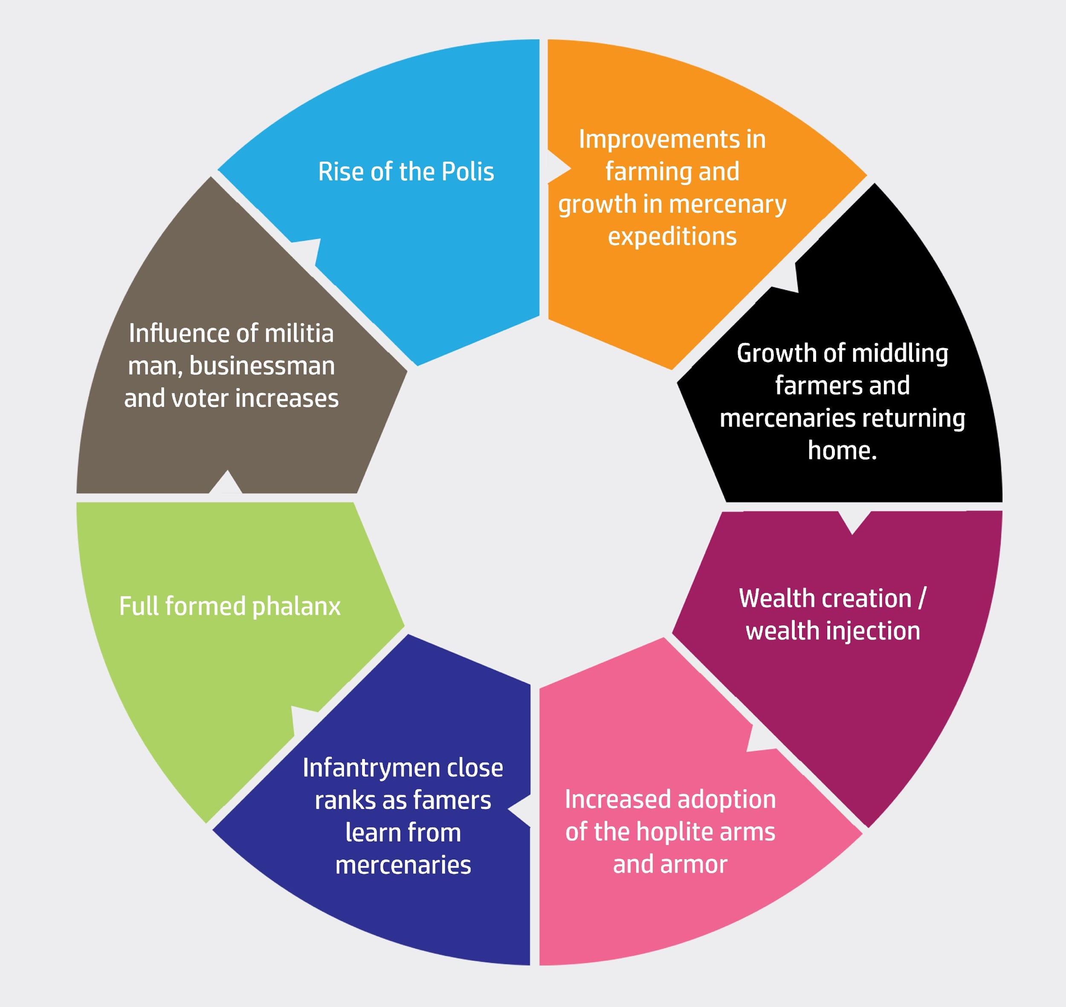
Notes:
Improvements in farming and growth in private mercenary expeditions which lead to wealth creation.
In order to afford the cost of the panoply, new wealth had to be created.
Hanson believes this wealth was created by a rise of a farmer class who demanded voting rights in return for military service.
Van Wees believes the wealth was already in the hands of the aristocratic leisure class.
Hale believes this wealth was created by traders, raiders, and mercenaries returning home from overseas expeditions in the Near East flush with wealth gained from their exploits.
As more people could afford the hoplite arms and armor, here was a gradual shift from the open order battle favored by Hans van Wees to the phalanx.
Hale’s mercenary returned home to join the phalanx of his polis and also demanded voting rights.
The hoplite was a combination of militia man, entrepreneur (farmer or professional soldier for hire) and VOTER.
This rise of the hoplites lead to changes in the political structures of ancient Greece and the rise of poleis.

Slide 30
Support from Hale
“Mercenary service and raiding expeditions were part of the environment in which Greek hoplites EVOLVED.” [my emphasis]
Notes:
Hale even supports my model. ☺
The debate continues. There is no clear definitive answer.
The big challenge is that we can only infer from conflicting sources.
I am afraid we might not ever know what REALLY happened.

Slide 31
Questions?

Slide 32
References
Hanson, Victor Davis. The Western Way of War: Infantry Battle in Classical Greece. New York: Knopf, 1989.
Herodotus. The Landmark Herodotus. Translated by Andrea L. Purvis. New York: Anchor Books, 2007.
Kagan, Donald, and Gregory F. Viggiano. Men Of Bronze. Princeton: Princeton University Press, 2013.
Luraghi, Nino. "Traders, Pirates, Warriors: The Proto-History of Greek Mercenary Soldiers in the Eastern Mediterranean." Phoenix 60, no. 1 (2006): 21-47.
van Wees, Hans. Greek Warfare Myths and Realities. London: Bloomsbury Academic, 2004.
van Wees, Hans. "The Homeric Way of War: The 'Iliad' and the Hoplite Phalanx (II)." Greece and Rome (Cambridge University Press) 41, no. 2 (1994).
Hoplite image: http://www.ancient.eu/image/152/ 4th Century Hoplite by Johnny Shumate shumate_j@bellsouth.net
Corinthian helmet: http://commons.wikimedia.org/wiki/File:Corinthian_helmet_Denda_Staatliche_Antikensammlungen_4330_n2.jpg
Chigi Vase: http://sites.psu.edu/thehopliteexperience/wp-content/uploads/sites/10736/2014/03/Hoplite-battle-Chigi-Vase.jpg
Phalanx vs. open order drawing: Men of Bronze
Iliad cover: http://billwardwriter.com/wp-content/uploads/2010/03/fagles-iliad.jpg
Picture of Victor Davis Hanson - http://www.asmeascholars.org/wp-content/uploads/2013/04/victor_davis_hanson_headshot.jpg
Picture of Hans Van Wees - http://www.ucl.ac.uk/history/people/academic-staff/hans-vanwees/Hans_van_Wees_03.jpg
Picture of John R. Hale - http://louisville.edu/liberalstudies/team/images/hale.jpg/image_preview
Skirmisher: http://en.wikipedia.org/wiki/Skirmisher#mediaviewer/File:Agrianian3.jpg Agrianian Peltast by Johnny Shumate For more information about illustrations, email shumate_j@bellsouth.net
Amathus bowl: Men of Bronze
Van Wees skirmishers: Men of Bronze
Kagan Yale Course: http://oyc.yale.edu/classics/clcv-205

